Slide 1

Abnormal Heart Rate Monitor
Nishat Tarannum

Slide 2
Aims of Project
Detects irregularities in heart beat rhythm without going to a doctor
Portable
Compact
Cheap
Easy to use/setup

Slide 3
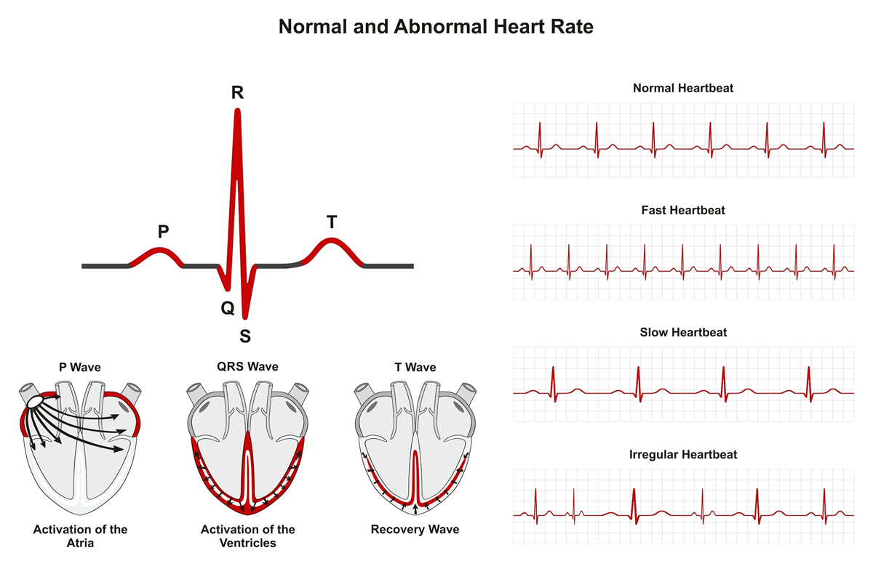
Arrhythmia

Slide 4
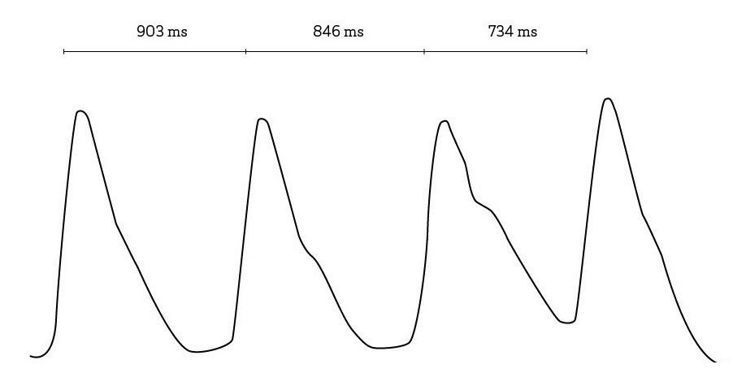
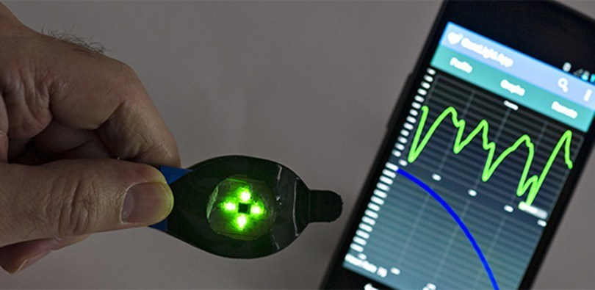
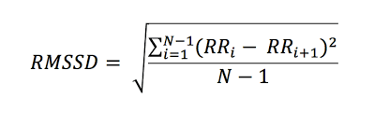
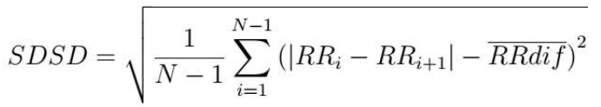
PPG and Heart Rate Variability

Slide 5
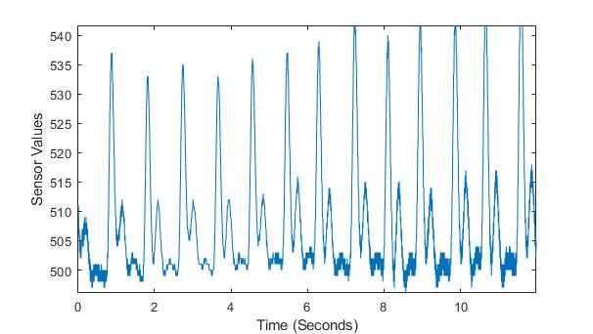
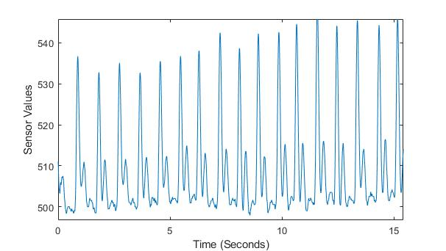
Pre-processing
Unfiltered
Filtered

